Slide 1
Data Communication between Vehicles and the Server

Slide 2
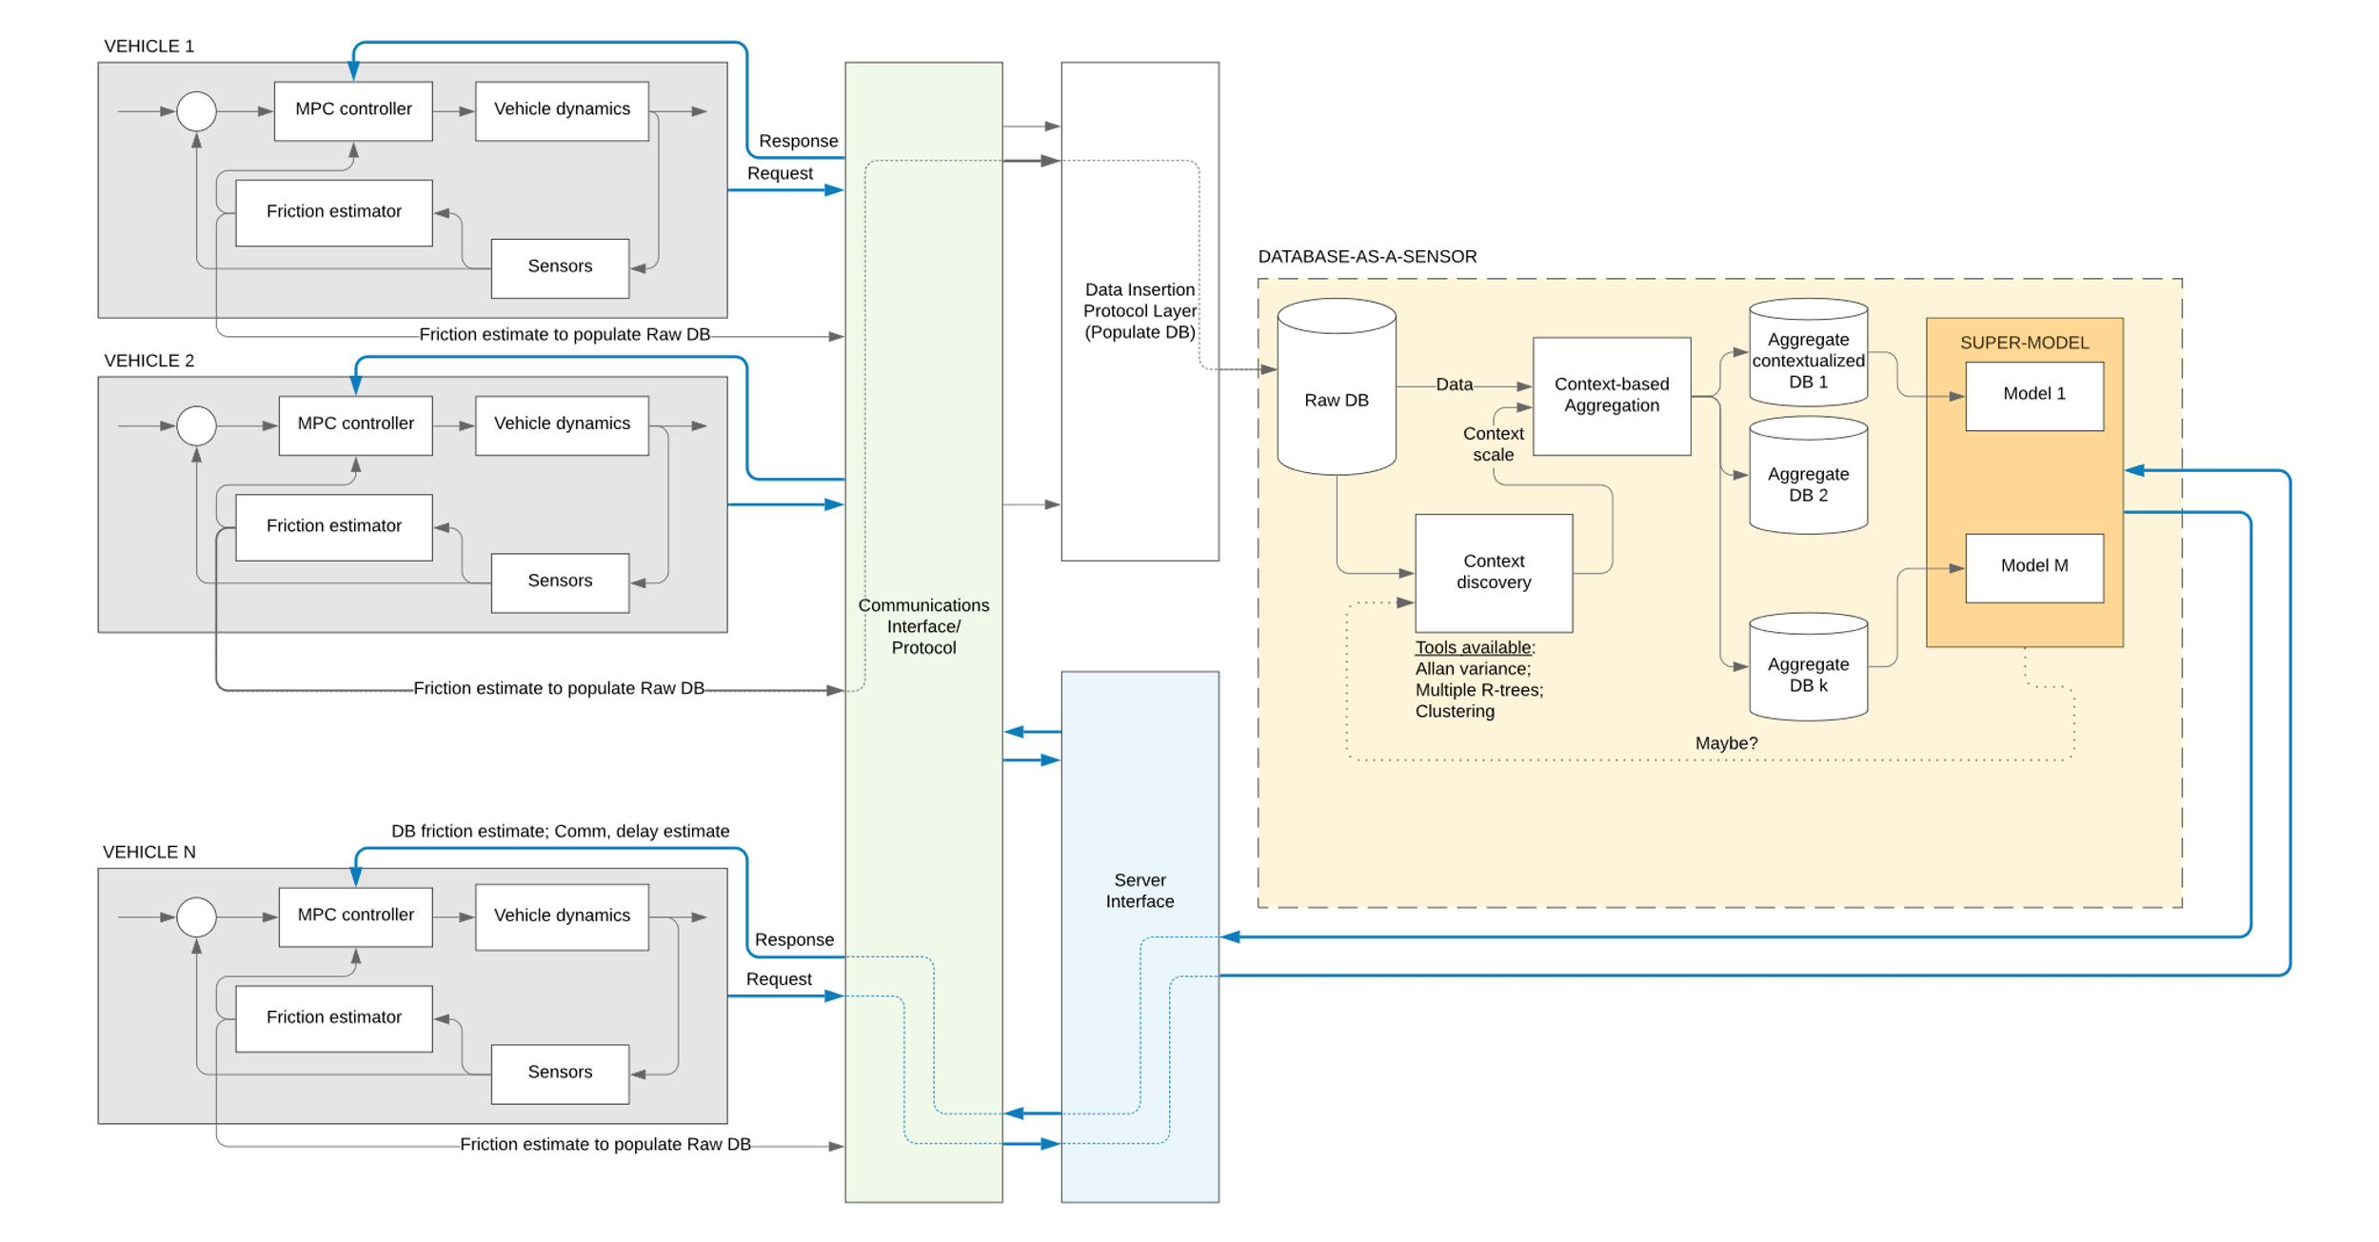
Simulator
(MATLAB Simulink)
Interface
(UDP)
Server

Slide 3
Data flow pipeline (Specifically for the Demo)
Direct insertion of measurements
MATLAB Simulink
Database
Preview Response
(UDP)
Preview Request (UDP)
Pulling raw data to update the model
Server Interface
(Python Script)

Slide 4
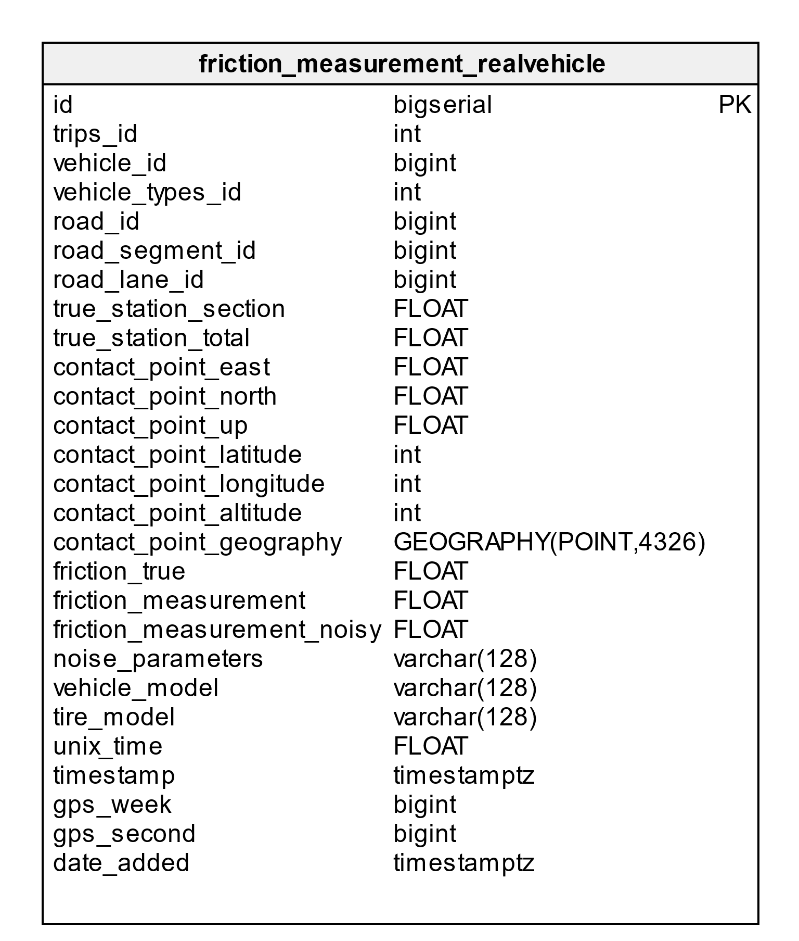
Measurement (from Simulink to DB)
Direct insertion to the database

Slide 5
Preview Request (from Simulink to Server)
UDP (comma separated string packet)
vehicle_id
vehicle_types_id
road_id
road_segment_id
road_lane_id
true_station_section
prev_station_section
gps_time
latitude
longitude
altitude

Slide 6
Preview Response (from Server to Simulink)
UDP (comma separated string packet)
road_id
road_segment_id
road_lane_id
(s_0, d_0, f_0)
(s_1, d_1, f_1)
…
(s_n, d_n, f_n)

Slide 7
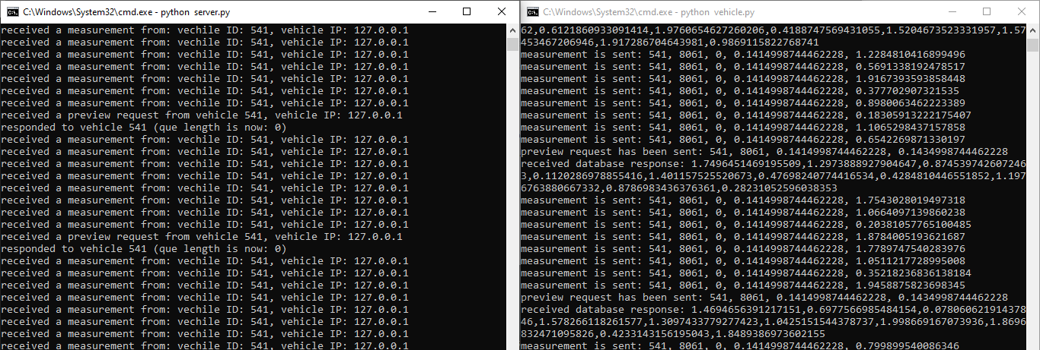
Example of UDP communication
Server interface
(python script)
Vehicle interface
(python script)

